Slide 1
Digging into Deep Learning
Xu Pan
Compuataional Neuroscience CSC550/650 2024 spring

Slide 2
4 components of DL
Data
Architecture
Loss function
Learning rules

Slide 3
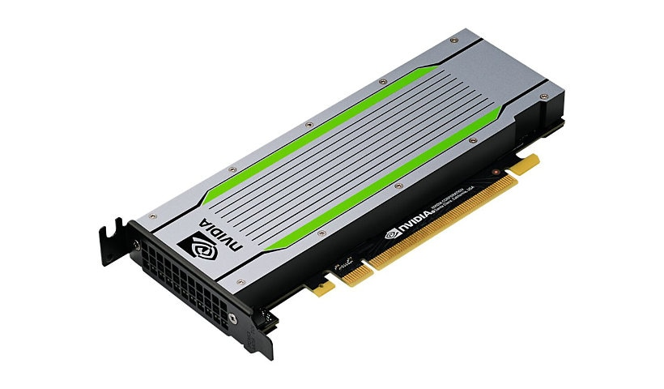
1. Data pipline
Goal: Feed GPU a batch of training data (input output pairs)
Hard drive
SSD
Clould storage
RAM
Virtual memory
GPU memory
https://www.tensorflow.org/guide/data_performance
https://lilianweng.github.io/posts/2021-09-25-train-large/

Slide 4
2. Network structure
Dense, convolution, attention…
Skip connections
Modular
Other computation: pooling, dropout…
One thing in common: n x (linear + nonlinear)

Slide 5
3. Loss function
https://keras.io/api/losses/
https://www.tensorflow.org/api_docs/python/tf/keras/losses?version=nightly
Regularization loss (L1, L2)
Large models usually have multiple loss
Mask R-CNN combines the loss of classification, localization and segmentation mask: L=Lcls+Lbox+Lmask

Slide 6
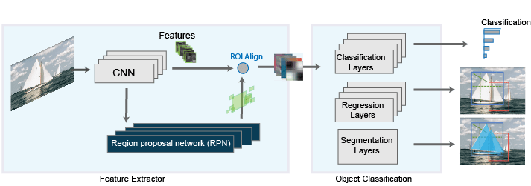
Mask RCNN

Slide 7

4. Learning algorithm
Gradient decent: SGD, RMSprop, ADAM
Batch learning
Backprop and chain rule
$$w_{t+1}=w_{t} − α\frac{∂L}{∂w}$$

Slide 8
4. Learning algorithm
Backprop is Reverse-mode automatic differentiation
forward accumulation (also called bottom-up, forward mode, or tangent mode)
reverse accumulation (also called top-down, reverse mode, or adjoint mode)
A simple example:
Further reading:
https://en.wikipedia.org/wiki/Automatic_differentiation
Build your own: https://sidsite.com/posts/autodiff/

Slide 9
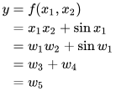
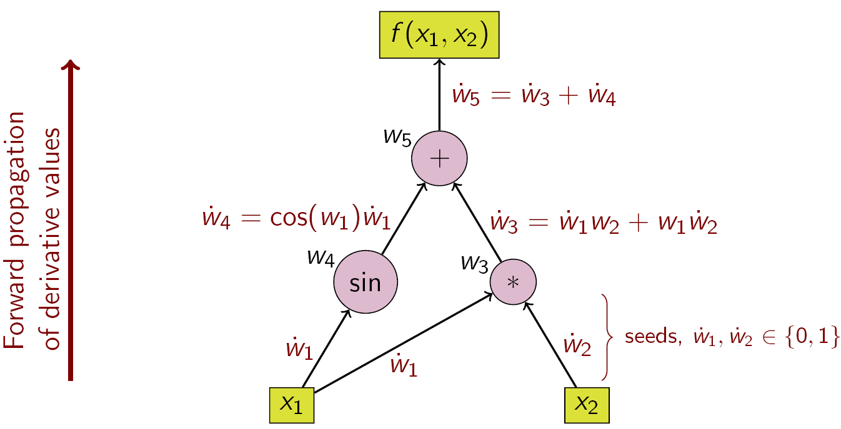
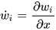
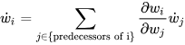
4. Learning algorithm
A more complicated example:
Further reading:
https://en.wikipedia.org/wiki/Automatic_differentiation
Build your own: https://sidsite.com/posts/autodiff/

Slide 10
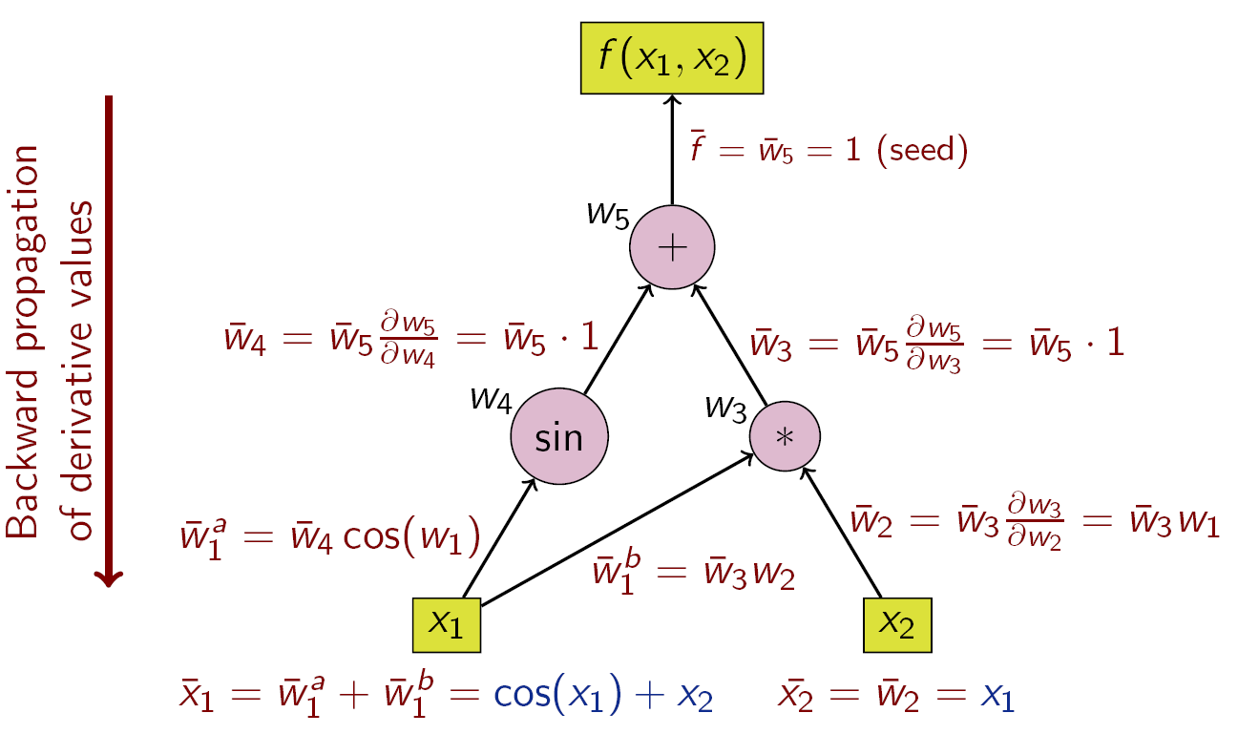
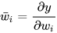
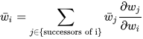





4. Learning algorithm
A more complicated example:
Further reading:
https://en.wikipedia.org/wiki/Automatic_differentiation
Build your own: https://sidsite.com/posts/autodiff/

Slide 11
NeuroAI

Slide 12
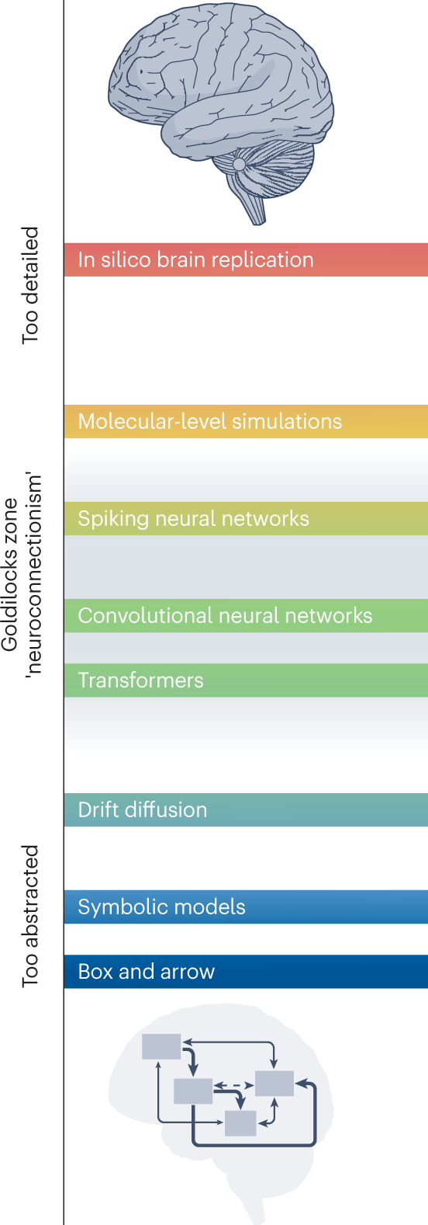
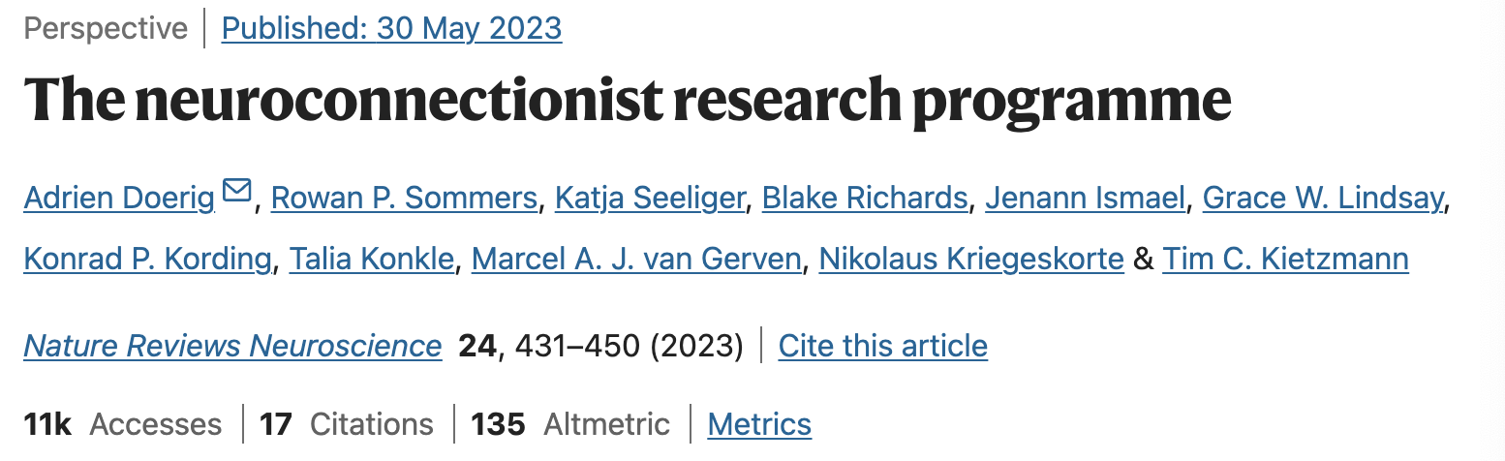
“ANNs offer a highly suitable computational language: sufficiently abstract to be computationally tractable and reproduce cognitive functions, while still being close enough to biology to relate to, implement and test neuroscientific hypotheses.”

Slide 13
“ANNs are defined by their architecture, data set statistics, objectives and learning rules, which can be mapped onto central questions of brain science.
This includes
disentangling the interacting contributions of pre-specified structure (for ANNs: determined by the architecture) and experienced input (for ANNs: training data set),
why neural selectivity in any given brain region is the way it is (for ANNs: which objectives are being optimized) and
how the brain may adjust its internal representations (for ANNs: credit assignment or learning rules).”

Slide 14
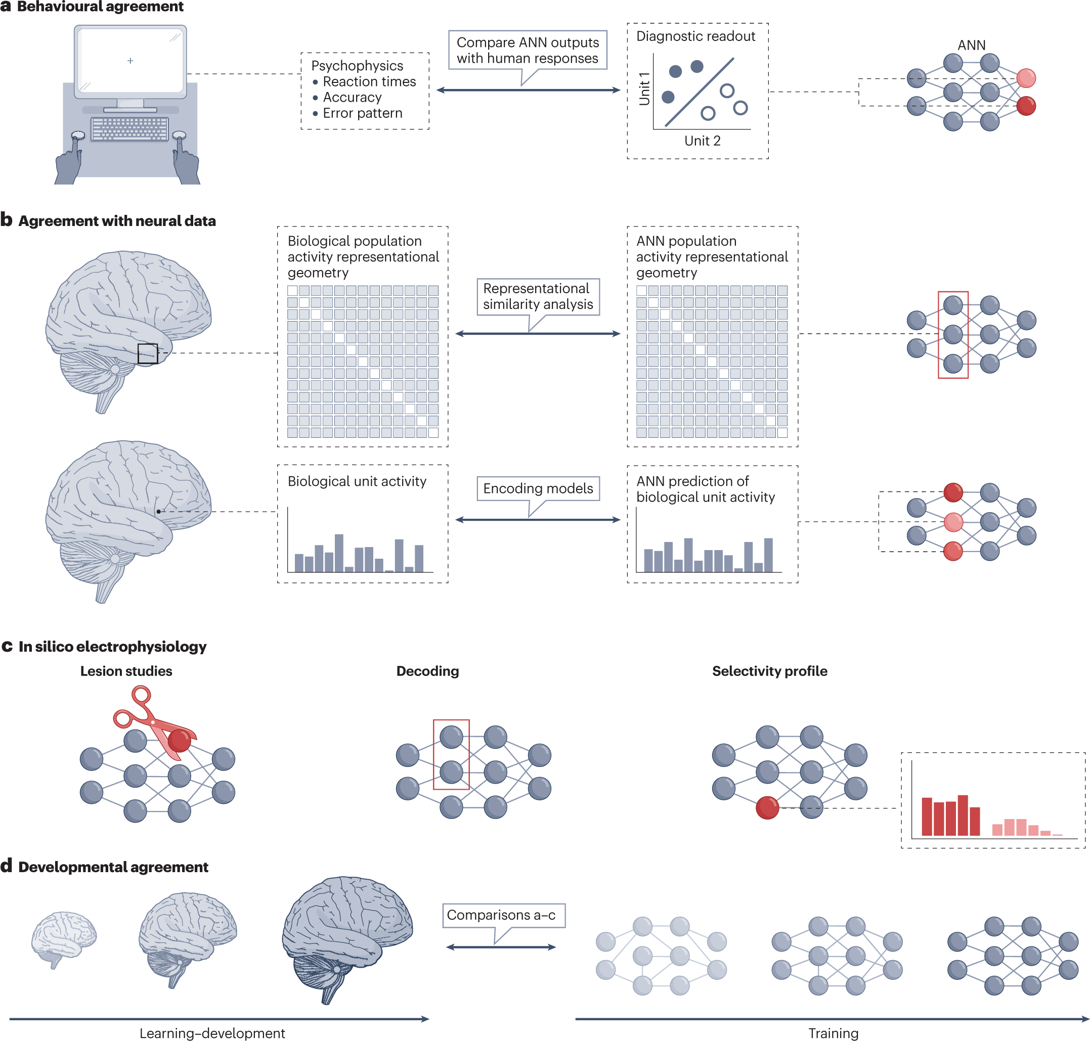

Slide 15
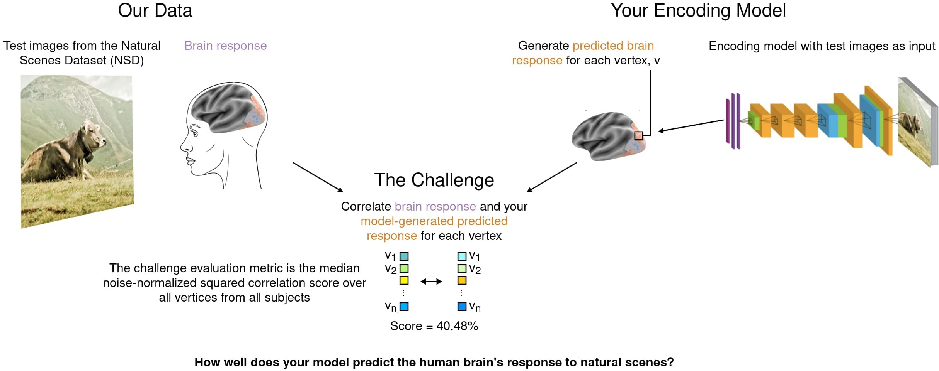
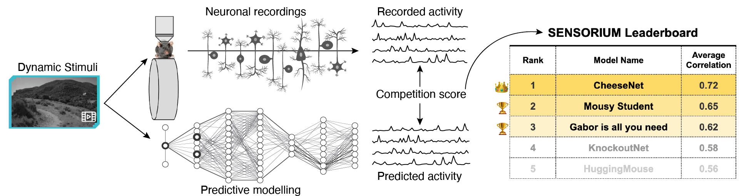
Encoding Models
“The activity of each biological unit (neuron or voxel) is predicted as a linear combination of ANN unit activations.”
Algonauts
Sensorium
Brain-score

Slide 16
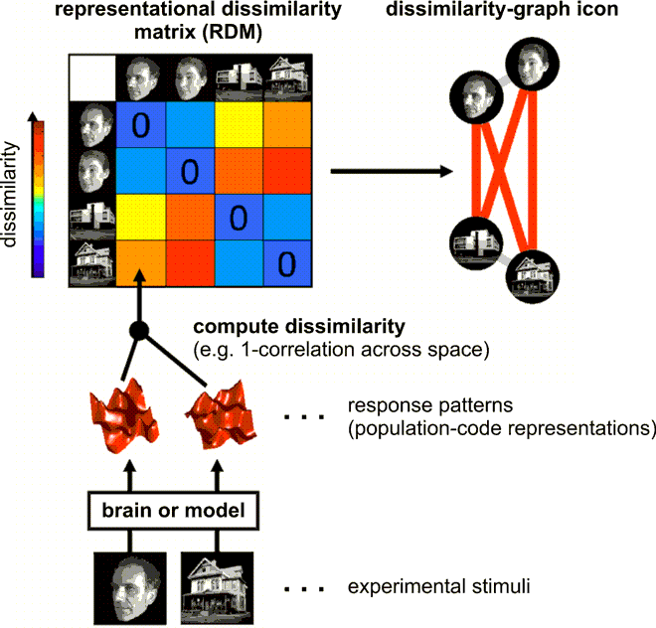
Representational Similarity Analysis
“RSA characterizes the internal representations of a system by quantifying the dissimilarities between the population activity patterns during different experimental conditions.”

Slide 17
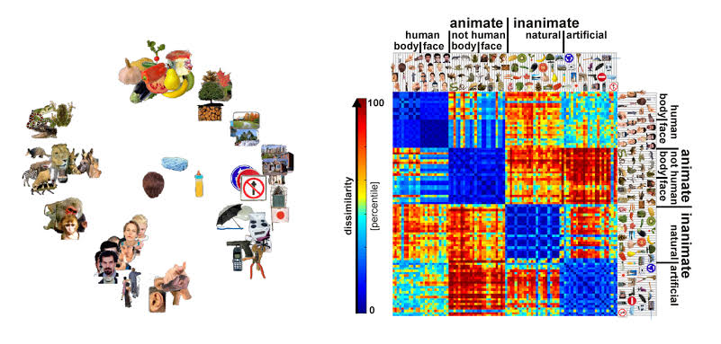
Representational Similarity Analysis

Slide 18
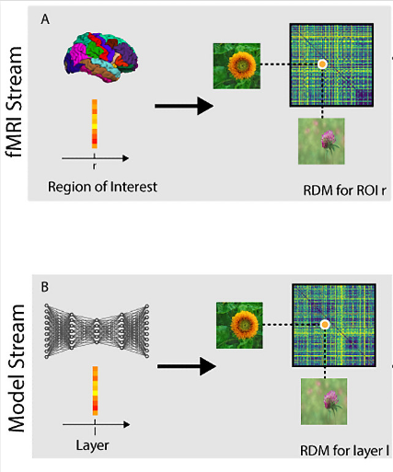
Representational Similarity Analysis
Correlation

Slide 19
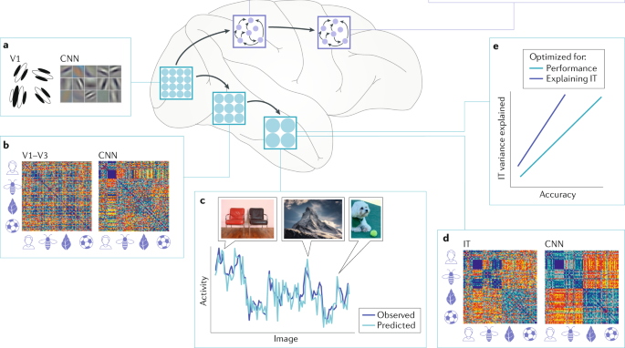
Representational Similarity Analysis
Figure from Saxe, Nelli, Summerfield, 2021

Slide 21
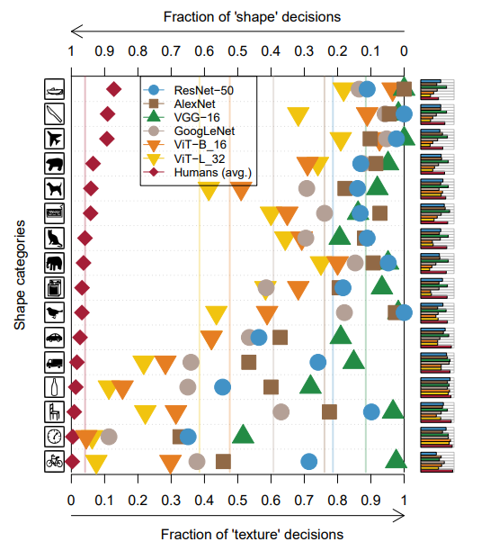
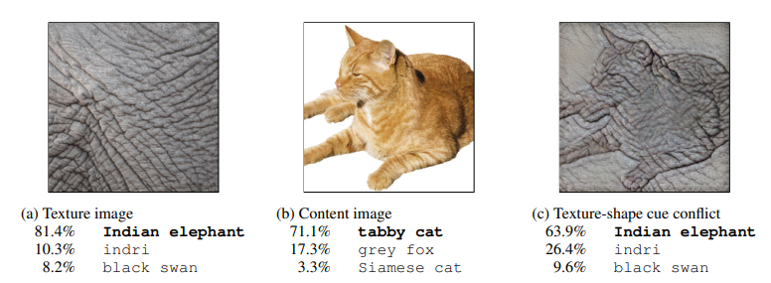
Behavioral agreement
Geirhos, Robert, et al. 2018.
Tuli, Shikhar, et al. 2021.

Slide 22
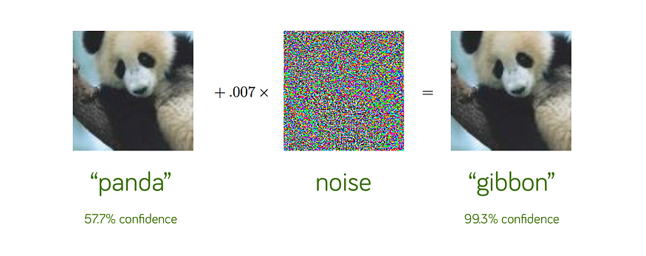
Behavioral agreement
Adversarial attacks

Slide 24
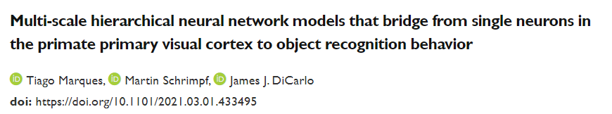
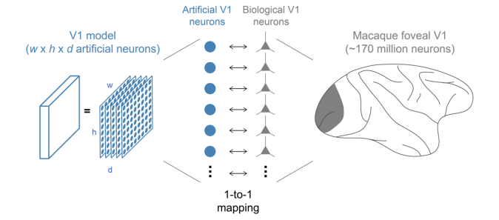
In-silico electrophysiology

Slide 25
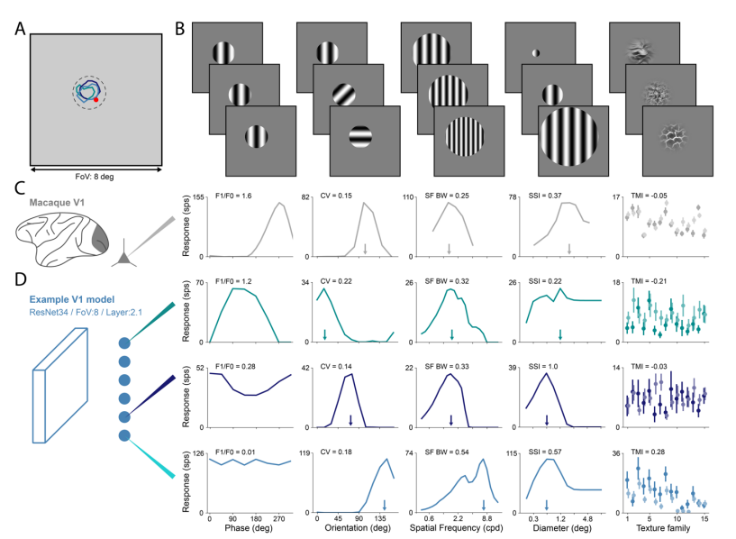
In-silico electrophysiology

Slide 26
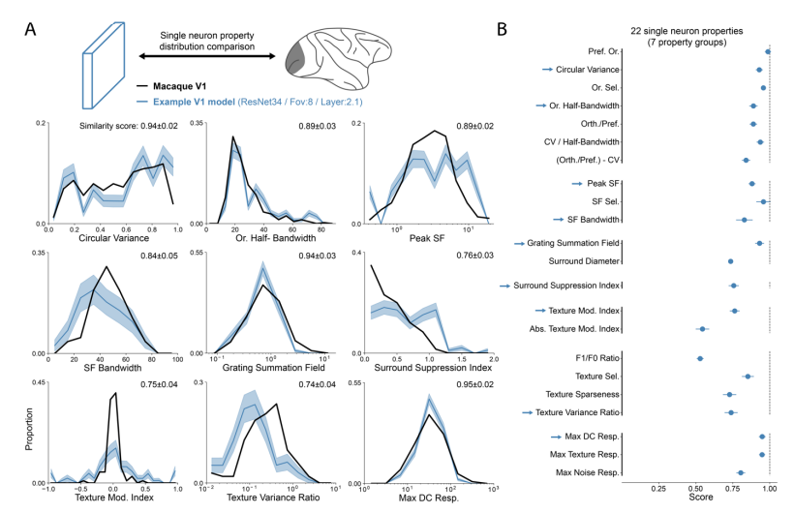
In-silico electrophysiology

Slide 27
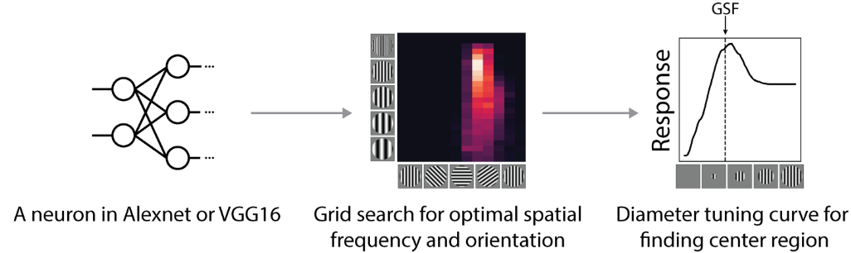
In-silico electrophysiology
Pan, X., DeForge A., Schwartz O. (2023) Generalizing biological surround suppression based on center surround similarity via deep neural network models. PLoS Comput Biol

Slide 28
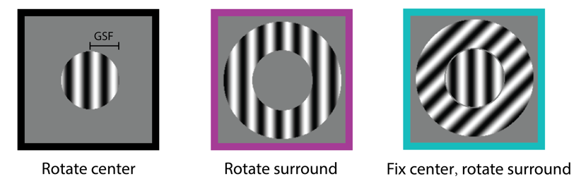
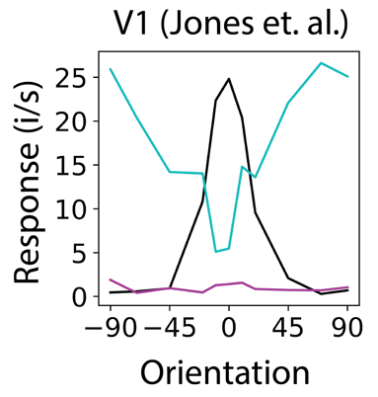
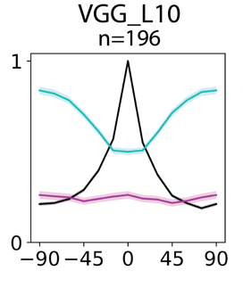
In-silico electrophysiology
Pan, X., DeForge A., Schwartz O. (2023) Generalizing biological surround suppression based on center surround similarity via deep neural network models. PLoS Comput Biol

Slide 29
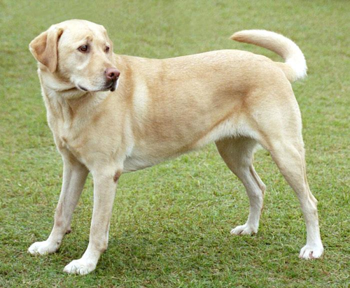
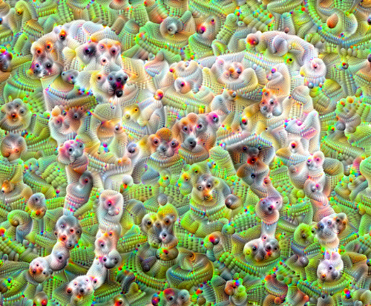
Feature visualization
Deep dream
https://www.tensorflow.org/tutorials/generative/deepdream

Slide 30
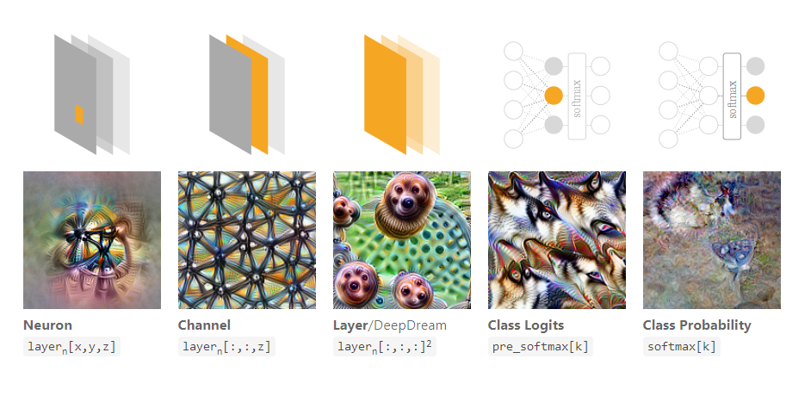
Feature visualization
Olah, Chris, Alexander Mordvintsev, and Ludwig Schubert. "Feature visualization." Distill 2.11 (2017): e7.

Slide 31
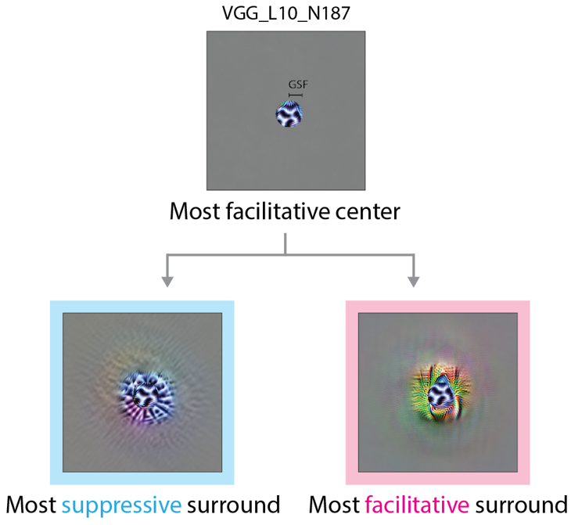
In-silico electrophysiology
Pan, X., DeForge A., Schwartz O. (2023) Generalizing biological surround suppression based on center surround similarity via deep neural network models. PLoS Comput Biol

